Slide 1
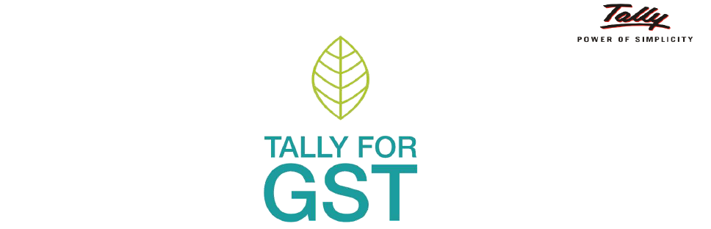
(GST) GOODS AND SERVICES TAX
A Presentation by
Mr. Sachin Sirohi

Slide 2
Concept of GST
The tax came into effect from 1 July 2017.
Goods and Services Tax (GST) is an indirect tax (or consumption tax) used in India on the supply of goods and services.
Goods and services are divided into five different tax slabs for collection of tax - 0%, 5%, 12%, 18% and 28%.
However, petroleum products, alcoholic drinks, and electricity are not taxed under GST and instead are taxed separately by the individual state governments.
There is a special rate of 0.25% on rough precious and semi-precious stones and 3% on gold

Slide 3
Concept of GST
HSN code:-
It was originally using 6-digit HSN codes to classify commodities for Customs and Central Excise.
E-Way Bill:-
An e-Way Bill is an electronic permit for shipping goods any another similar to a waybill. It was made compulsory for inter-state transport of goods from 1 June 2018. It is required to be generated for every inter-state movement of goods beyond 10 kilometres (6.2 mi) and the threshold limit of ₹50,000 .

Slide 4
Existing Tax structure in India
Tax Structure
Direct Tax
Income Tax
Wealth Tax
Indirect Tax
Central Tax
State Tax
Excise
Service Tax
Custome
VAT
Entry Tax, luxury tax, Lottery Tax, etc.
Notes:
wealth tax is a tax levied on the value of assets someone holds. A wealth tax is applicable to a variety of asset types, including cash, bank deposits, shares, fixed assets, personal cars, assessed value of real property, pension plans, money funds, owner-occupied housing, and trusts

Slide 5
Proposed Tax Structure in India
Tax Structure
Direct Tax
Income Tax
Wealth Tax
Indirect Tax = GST (Except customs)
Intra- state
Inter State
CGST (Central)
IGST (Central)
SGST (State)

Slide 6
Subsuming of Existing Taxes
CGST
Central Excise
Additional duties of Custom (CVD)
Service Tax
SGST
VAT/sales tax
Entertainment Tax
Luxury Tax
Lottery Tax
Entry Tax
Purchase Tax
Stamp Duty
Goods and passenger Tax
Tax on vehicle
Electricity, banking, Real state
Surcharges and all cesses
IGST
CST

Slide 7
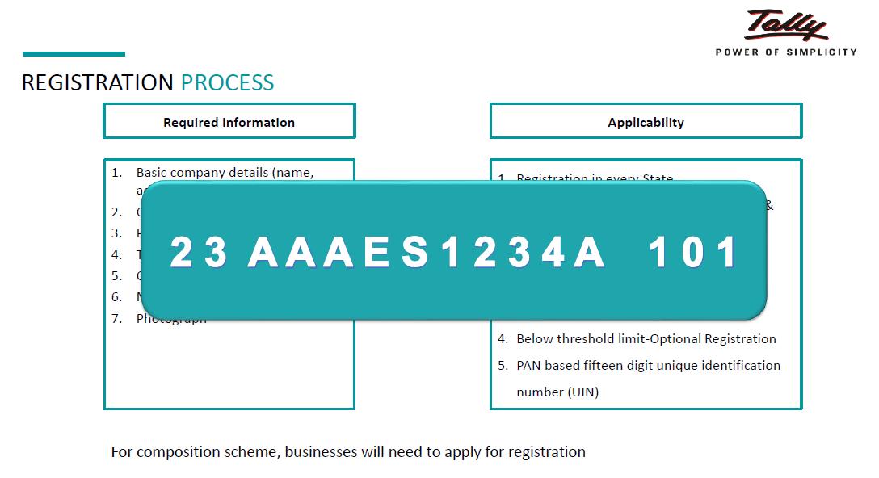
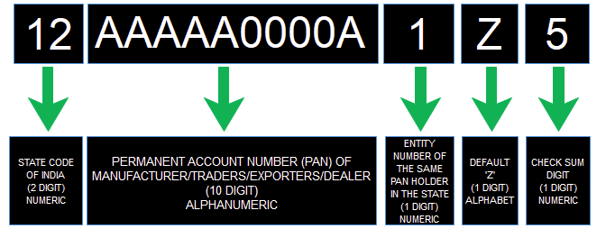

Slide 8
Thank You

